Slide 1
Brainathon-2025: EEG Attention Multi-classification Challenge
Comprehensive Analysis of Brain Attention Paradigms
Sahil Rane
SY-IT, Btech Undergrad
Individual Submission

Slide 2
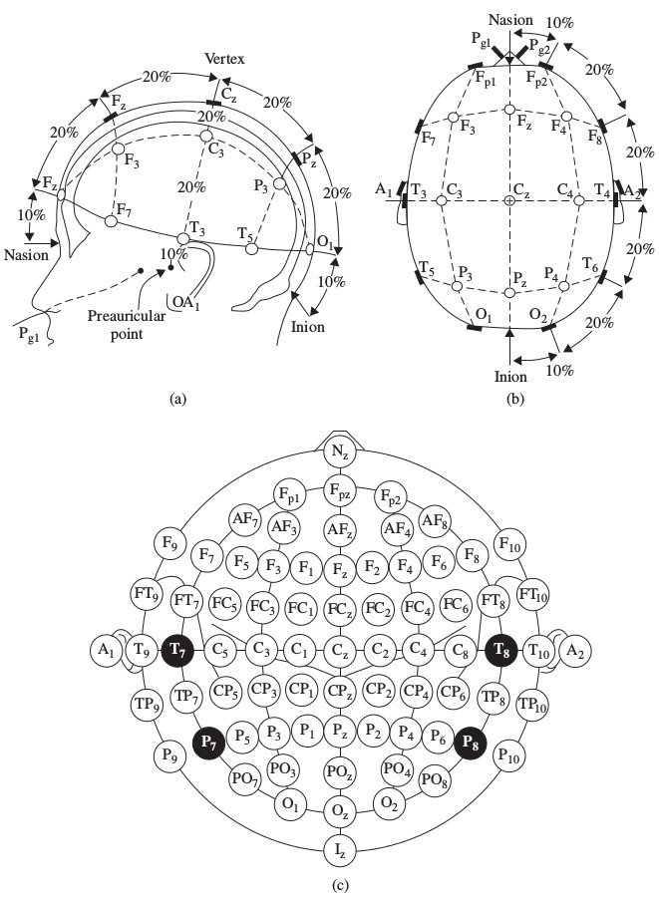
1. Introduction
1.1 Project Overview :
The Brainathon-2025 challenge focuses on multiclass classification of EEG signals across different attention paradigms. The primary objective is to understand how the human brain processes various types of attention through advanced signal processing and machine learning techniques.
Summary :
This report presents a comprehensive analysis of EEG data collected during the Brainathon-2025 EEG Attention Multi-classification Challenge. By examining brain signals across multiple attention paradigms, we provide insights into cognitive processing and neural dynamics.

Slide 3
1.2 Dataset Characteristics
• Subjects: 24 healthy individuals (aged 20-50 years)
• EEG System: 8-channel dry EEG system (Brain Product)
• Sampling Frequency: 250 Hz
• EEG Channels: Fp1, Fp2, F3, Fz, F4, Cz, Pz, Oz

Slide 4
1.3 Attention Paradigms
1. Baseline Recordings:
• Eyes Open: 30 seconds of quiet focus
• Eyes Closed: 30 seconds of relaxed state
2. Experimental Paradigms:
• Oddball Paradigm: Focused attention
• Stroop Task: Selective attention
• Task-Switching Paradigm: Alternating attention
• Dual-Task Paradigm: Divided attention

Slide 5
2. Methodology
Purpose :
To provide a comprehensive, transparent description of the data processing and analysis techniques.
2.1 Data Preprocessing
• Bandpass Filtering: Applied Butterworth bandpass filter (1-50 Hz)
• Feature Extraction: Computed time-domain and frequency-domain features

Slide 6
2.2 Feature Extraction
1. Time-Domain Features:
• Mean
• Standard Deviation
• Minimum
• Maximum
2. Frequency-Domain Features:
• Power Spectral Density (PSD) for frequency bands:
• Delta (1-4 Hz), Theta (4-8 Hz), Alpha (8-12 Hz), Beta (13-30 Hz), Gamma (30-45 Hz)
• Alpha/Beta Ratio, Theta/Alpha Ratio

Slide 7
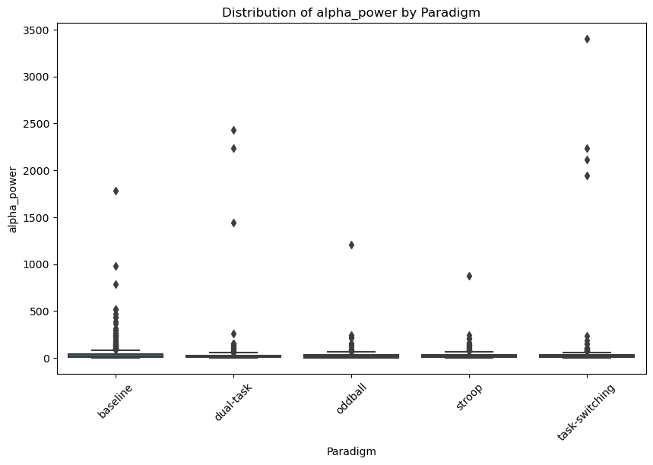
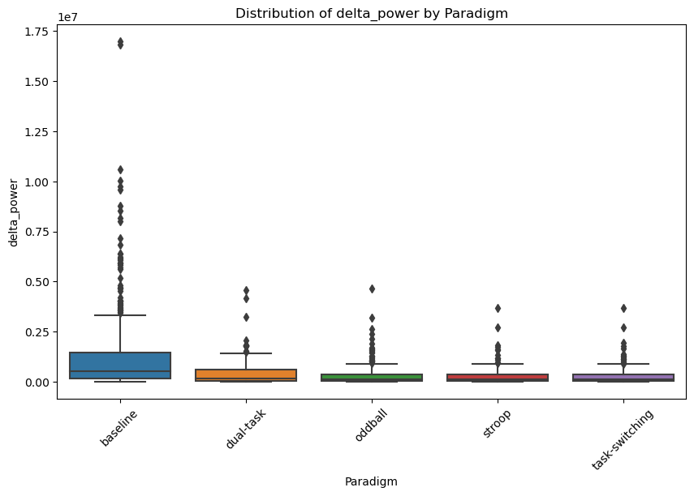
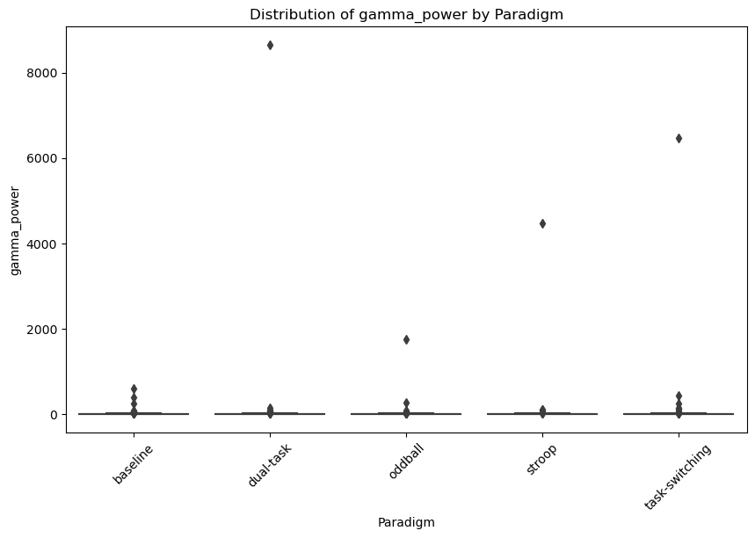
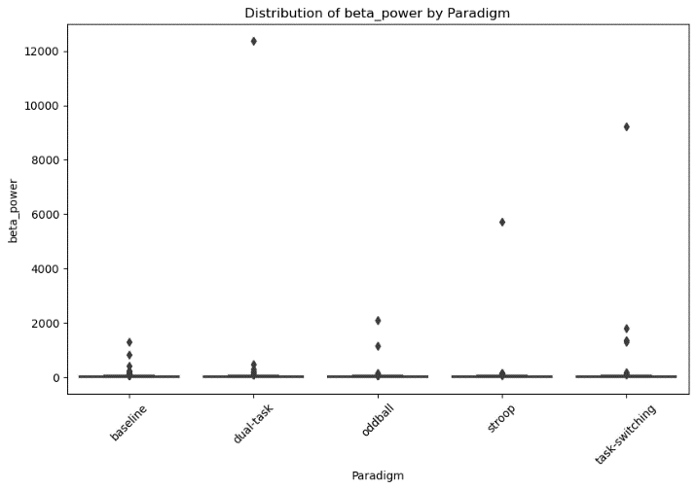
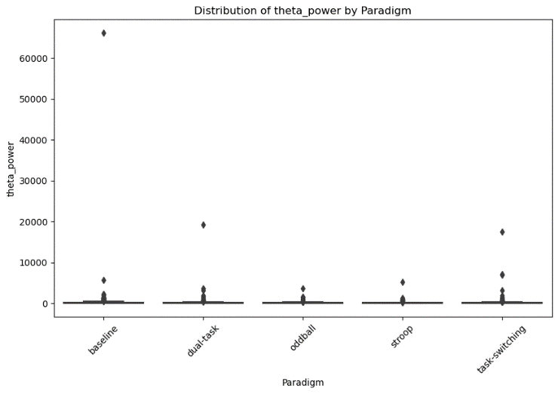
3.1 Power Distribution
The boxplot tells about the distribution of power across different attention paradigms. Variations in power can indicate differences in cognitive states and attentional processes.

Slide 8
What does the Delta power analysis tell us? [Neurophysiological Interpretation of Delta Power Outliers]
The box plot outliers reveal important patterns in delta power across different tasks:
Baseline Task: A few subjects show extremely high delta power outliers, indicating a state of significant neural relaxation or disengagement.
Cognitive Tasks (Dual Task, Odd Ball, Stroop, Task Switching): Some subjects have delta power outliers not above average, suggesting consistency in neural activity. The outliers across these tasks are almost the same, showing a stable pattern of neural response.
Interpretation:
Neural Relaxation: High delta power during Baseline indicates deep relaxation or disengagement.
Consistent Neural Response: Similar delta power outliers in cognitive tasks suggest stable cognitive strategy and neural efficiency across different tasks.
Delta waves (0.5-4 Hz) are linked to
deep sleep, physical healing, and an unconscious state.

Slide 9

What does the theta power Analysis tell us? [Neurophysiological Interpretation of theta Power Outliers]
The box plot reveals that a minority of subjects exhibit exceptionally high theta power during the baseline, indicating significant neural relaxation. There are very few subjects with below-average theta power, and these are almost at the same level for the dual task and task-switching conditions. Additionally, the theta power outliers are extremely close for the oddball and Stroop tasks. It shows :
Neural Relaxation: Extremely high theta power during the baseline suggests significant neural relaxation.
Consistent Cognitive Load: Below-average theta power in dual tasks and task-switching suggests consistent cognitive load management.
Stable Neural Responses: Similar theta power outliers in oddball and Stroop tasks indicate stable neural responses across these tasks.
Theta waves (4-8 Hz) are associated with relaxation, creativity, and light sleep.

Slide 10
What does the alpha power analysis tell us? [Neurophysiological Interpretation of Alpha Power Outliers]
The box plot outliers reveal that some subjects are extremely relaxed or disengaged during task-switching and dual-tasking. This indicates potential differences in their cognitive strategies. Which potentially means:
Cortical Inhibition: Elevated alpha power (8-12 Hz) may help these subjects suppress distractions, maintaining a relaxed state.
Cognitive Strategy Variability: These subjects might use different cognitive approaches to manage tasks, showing unique neural processing.
Neuroplasticity: These outliers might reflect adaptive brain changes, suggesting personalized ways of handling cognitive demands.
Alpha waves (8-12 Hz) are associated with calmness, a meditative state, and light focus.

Slide 11
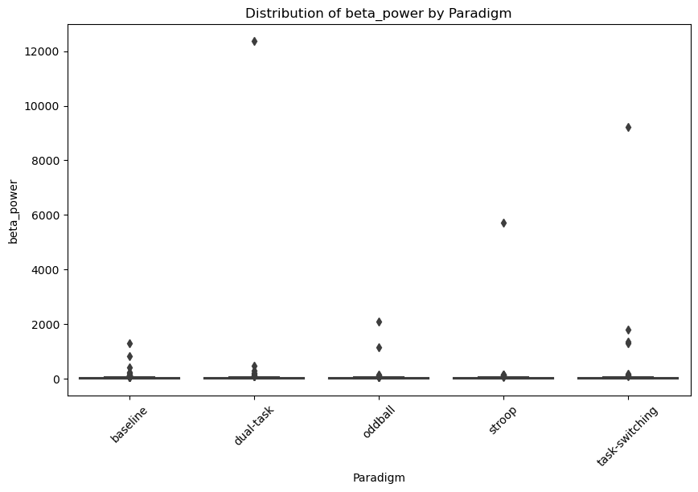
What does the beta power analysis tell us? [Neurophysiological Interpretation of beta Power Outliers]
The box plot reveals that a minority of subjects exhibit exceptionally high beta power during the dual task, indicating intense neural activity. Similarly, elevated beta power is observed in a few subjects during the task-switching task. In contrast, the Stroop task and oddball task show mostly average beta power outliers, reflecting moderate and consistent neural engagement among subjects. This distribution is very similar to that of gamma power, indicating similar neural engagement patterns. This shows :
Intense Neural Activity: Extremely high beta power during dual tasks indicates significant cognitive load and engagement.
Cognitive Flexibility: Elevated beta power in task-switching tasks suggests active cognitive processing and adaptability.
Moderate Engagement: Average beta power in Stroop and oddball tasks reflects consistent, moderate neural engagement.
Similarity to Gamma Power: The beta power distribution closely mirrors the gamma power distribution, suggesting similar neural engagement patterns.
Beta waves (12-30 Hz) are associated with active thinking, problem-solving, and alertness.

Slide 12
What does the gamma power analysis tell us? [Neurophysiological Interpretation of gamma Power Outliers]
The box plot reveals that a minority of subjects exhibit exceptionally high gamma power during the dual task, indicating intense neural activity. Similarly, elevated gamma power is observed in a few subjects during the task-switching task. In contrast, the Stroop task and oddball task show mostly average gamma power outliers, reflecting moderate and consistent neural engagement among subjects. This suggests variability in cognitive strategies and neural efficiency across different attention tasks. This shows :
Intense Neural Activity: Extremely high gamma power during dual tasks indicates significant cognitive load and engagement.
Cognitive Flexibility: Elevated gamma power in task-switching tasks suggests active cognitive processing and adaptability.
Moderate Engagement: Average gamma power in Stroop and oddball tasks reflects consistent, moderate neural engagement.
Variability in Strategies: Differences in gamma power indicate diverse cognitive strategies and neural efficiency among subjects
Gamma waves (30-100 Hz) are linked to higher cognition, memory, and sensory integration.

Slide 13
3.2 Feature Correlation Heatmap
The correlation heatmap illustrates significant interactions between different EEG frequency band powers, providing valuable insights into neural processing dynamics :
Delta Power: Shows a negative correlation with Gamma, Beta, and Alpha bands, suggesting that increases in delta activity typically accompany decreases in these higher frequency activities. It has a less negative correlation with Theta, indicating a moderate inverse relationship.
Theta Power: Exhibits a negative correlation with Gamma and less negative correlations with Beta and Delta bands, reflecting a tendency for theta activity to inversely relate to these frequencies. It has a very slight positive correlation with Alpha, hinting at a minor supportive interaction.
Alpha Power: Maintains a neutral relationship with Gamma, a very slight positive correlation with Beta and Theta, and a negative correlation with Delta. This suggests a balanced yet moderately inverse interaction with lower frequency bands and a slight positive interaction with Theta and Beta.
Beta Power: Shows positive correlations with Gamma, indicating that increases in Beta activity often coincide with increases in Gamma activity. It has less positive correlations with Alpha and less negative correlations with Theta, while showing a negative correlation with Delta, signifying diverse interactions with different frequency bands.
Gamma Power: Positively correlates with Beta, maintains a neutral relationship with Alpha, exhibits a less negative correlation with Theta, and a negative correlation with Delta. This highlights the simultaneous engagement of Beta and Gamma bands and their combined inverse relationship with lower frequency bands like Delta and Theta.

Slide 14
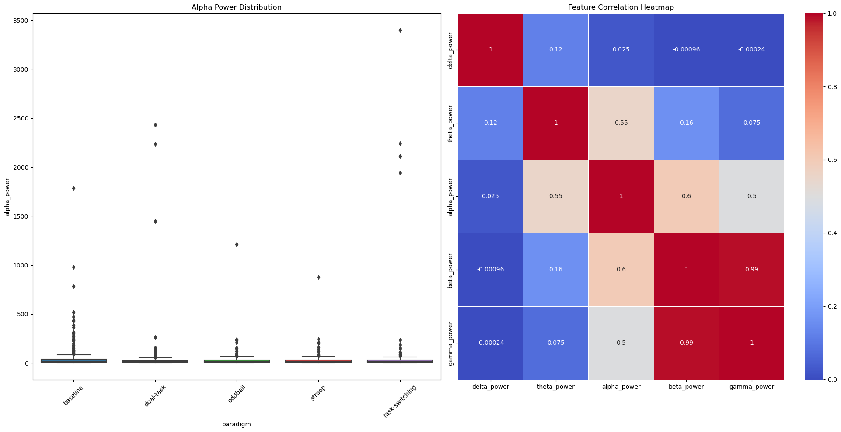
What does the feature co-relation map express?
Inference from Feature Correlation Heatmap :
Delta Power: Negatively correlated with Gamma, Beta, Alpha; less negative with Theta.
Theta Power: Negatively correlated with Gamma; less negative with Beta, Delta; very slightly positive with Alpha.
Alpha Power: Neutral with Gamma; very slightly positive with Beta, Theta; negative with Delta.
Beta Power: Positively correlated with Gamma; less positive with Alpha; less negative with Theta; negative with Delta.
Gamma Power: Positively correlated with Beta; neutral with Alpha; less negative with Theta; negative with Delta.

Slide 15
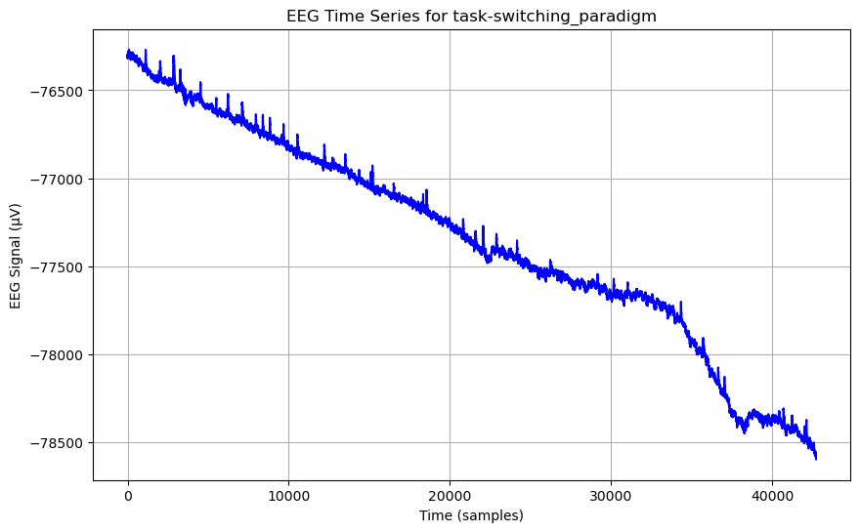
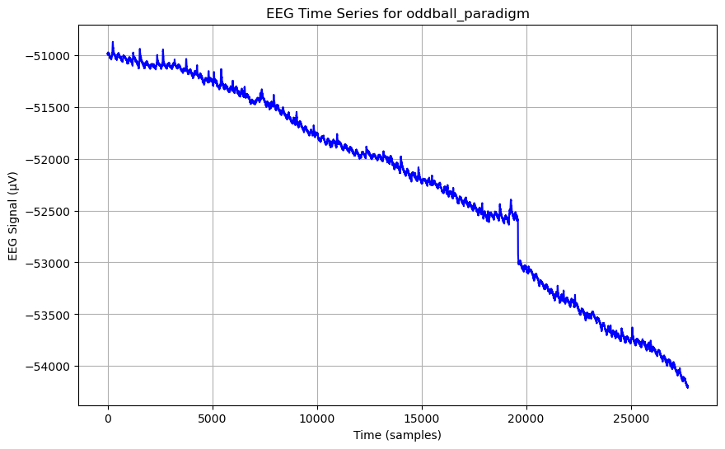
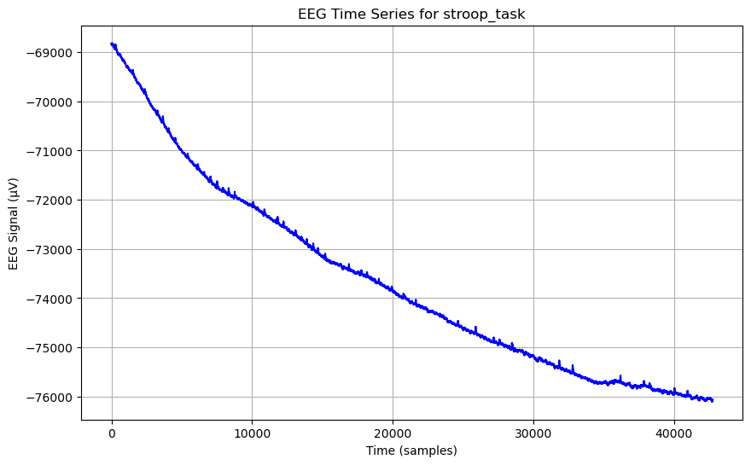
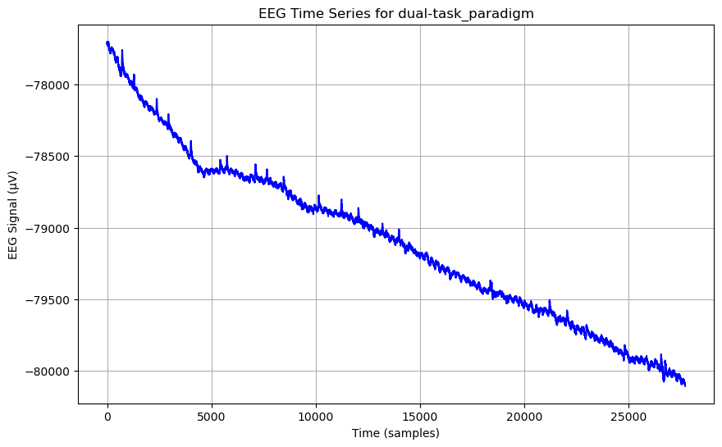
analysis of eeg signals
This analysis presents EEG signals (in microvolts) over time for four different tasks

Slide 16
analysis of eeg signals
Based on the observed EEG signal patterns for the four tasks, these insights can be drawn:
1. Stroop Task :
Linear Decrease: The EEG signals exhibit a consistent, linear decrease over time. This suggests a steady decline in neural activity as subjects become accustomed to the task, possibly reflecting a reduction in cognitive load as they process the stimuli more efficiently.
2. Dual Task :
Linear Decrease: Similar to the Stroop task, the Dual Task shows a linear decrease in EEG signals, indicating a gradual stabilization of neural activity. This pattern suggests that as subjects manage the dual demands, their brains settle into a more efficient processing state.
3. Oddball Task :
Vertical Decrement: There is a noticeable vertical drop in EEG signals just before the 20,000-time mark, followed by a return to a linear decrease. This abrupt change could indicate a moment of sudden cognitive adjustment or heightened engagement in response to unexpected stimuli, characteristic of the Oddball paradigm.
4. Task-Switching :
Noticeable Decrement: Around the 30,000-time mark, there is a significant drop in EEG signals. This pattern suggests a point of cognitive shift or increased demand on executive functions as subjects switch tasks, requiring additional cognitive resources to adjust to new rules.

Slide 17
analysis of eeg signals
Important Points Derived :
1. Steady Neural Engagement: The linear decrease in Stroop and Dual tasks indicates steady neural engagement and efficient processing over time.
2. Cognitive Adjustment: The vertical decrement in the Oddball task highlights moments of heightened cognitive adjustment in response to unexpected stimuli.
3. Executive Function Demand: The noticeable decrement in Task-Switching signals a significant demand on executive functions, reflecting the cognitive load associated with shifting mental sets.
These patterns provide valuable insights into how the brain dynamically adjusts to different cognitive tasks, reflecting varying levels of engagement, processing efficiency, and cognitive flexibility

Slide 18
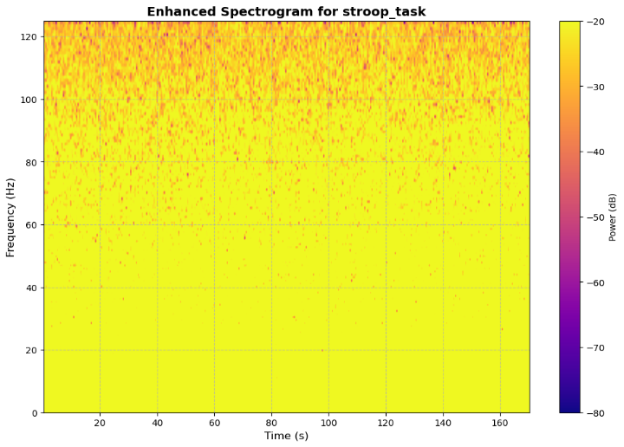
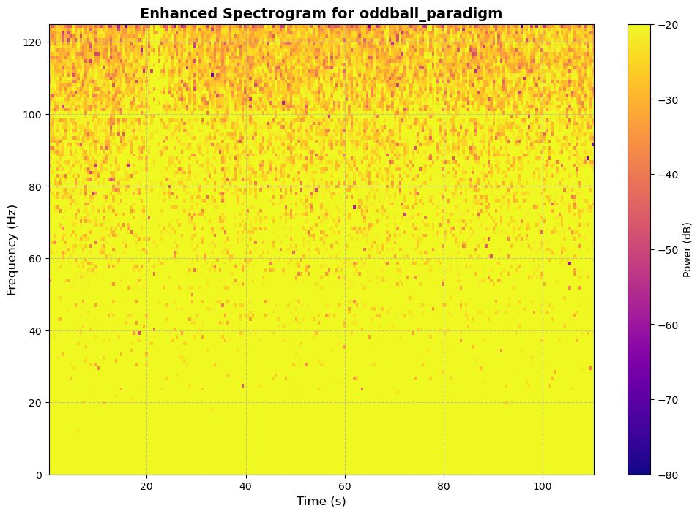
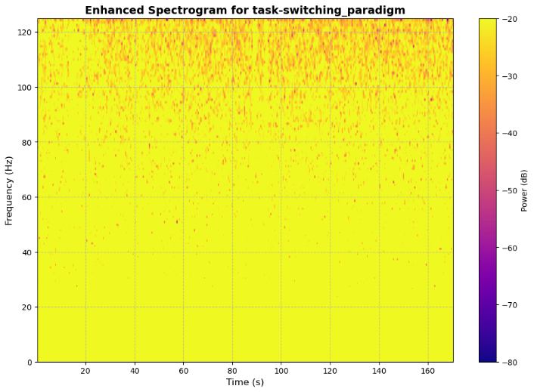
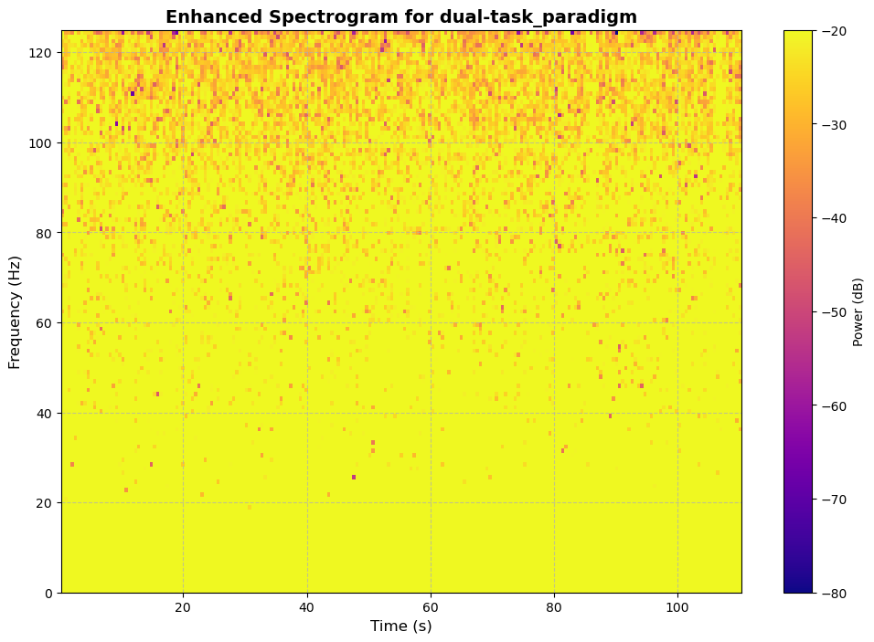
Spectrogram analysis for tasks
This slide showcases spectrograms for various tasks, illustrating the frequency content of EEG signals over time. By analyzing these spectrograms, we gain insights into how different cognitive tasks impact brain activity across various frequency bands.

Slide 19
Detailed Inference on Power Spectrogram Analysis
1. Dual Task:
Observation: Gamma power intensity increases over time.
Inference: As the dual task progresses, cognitive engagement and neural activity intensify. The rising gamma power reflects escalating cognitive load and increased attentional demands, indicating heightened focus and processing effort.
2. Oddball Task:
Observation: Gamma power remains relatively constant.
Inference: The stable gamma power suggests that subjects maintain a consistent level of neural engagement throughout the task. This indicates that the cognitive load and attentional demands stay steady while responding to the oddball stimuli.
3. Stroop Task:
Observation: Gamma power distribution remains stable.
Inference: Similar to the Oddball task, the steady gamma power suggests that subjects sustain consistent neural activity and cognitive control. This reflects the ongoing effort to resolve the conflict between word meaning and color, maintaining attention and cognitive regulation.
4. Task-Switching:
Observation: Gamma power intensity increases over time.
Inference: The rising gamma power indicates that as subjects switch between tasks, cognitive demands grow, reflecting increased neural engagement. This pattern highlights the need for heightened executive function and cognitive flexibility as tasks alternate.

Slide 20
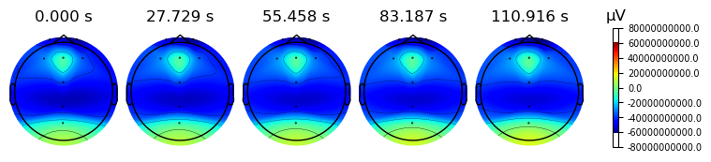
Topographical Analysis of EEG data
This provides a topographical analysis of EEG data, illustrating the spatial distribution of electrical activity across the brain's surface.

Slide 21
Topographical Analysis of EEG Data for the Oddball Task
Observation:
The topographical map of the oddball task reveals distinct patterns of brain activity:
Occipital Region: A greenish hue, indicating moderate activity, likely tied to visual processing as participants detect target stimuli.
Parietal Region: A gradient from green to blue suggests low to moderate engagement, reflecting sensory integration and attention.
Overall Gradient: Predominantly dark blues, indicating low activity across most regions, suggesting that the task is of relatively low cognitive demand.
Frontal Region: A bluish-green patch shows localized increased activity, pointing to the involvement of executive functions like decision-making and response inhibition.

Slide 22
Topographical Analysis of EEG Data for the Oddball Task
Inference:
Visual Processing: The moderate activity in the occipital region aligns with the visual nature of the oddball task, where participants focus on identifying target stimuli amid distractors.
Sensory Integration: The gradient of activity in the parietal region reflects the brain's role in sensory integration and managing attention, crucial for detecting rare stimuli.
Cognitive Control: The localized increased activity in the frontal region indicates involvement in higher-level cognitive processes, such as decision-making and response inhibition, key to correctly identifying the oddball stimuli.
Stable Neural Engagement: The consistent, steady neural activity across the brain over time suggests that subjects maintain a stable level of focus and attention throughout the task, efficiently processing the stimuli without large fluctuations in engagement.
These findings illustrate how different brain regions collaborate during the oddball task, with a stable yet dynamic interplay between visual processing, attention, and cognitive control. The analysis highlights the brain's ability to sustain neural engagement in response to relatively low-demand but attentionally demanding tasks.

Slide 23
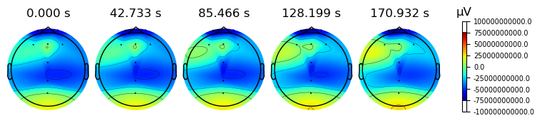
Topographical Analysis of EEG Data for the Stroop Task
Initial Observation:
Left Middle Frontal Gyrus: Displays a light green-bluish color, indicating moderate neural activity.
Frontal Lobe: Appears dark blue, reflecting low neural activity, typical during early cognitive control demands.
Occipital Lobe: Exhibits a green hue, suggesting moderate activity related to visual processing.
Lower Parietal Lobe: Shows a bluish gradient, indicating low to moderate neural engagement, likely supporting attention and sensory integration.
Changes Over Time:
Left Middle Frontal Gyrus: A distinct green patch emerges and expands, turning green-bluish, indicating increasing neural activity as cognitive demands rise.
Surrounding Areas: Adjacent regions of the left middle frontal gyrus transition to a greenish-blue hue, reflecting heightened neural engagement.
Overall Topography: Other regions maintain a light bluish gradient, suggesting stable but lower levels of neural activity.

Slide 24
Topographical Analysis of EEG Data for the Stroop Task
Inference:
Increased Frontal Activity: The expanding green patch in the left middle frontal gyrus signals increased cognitive control and conflict resolution, crucial for the Stroop task where participants must resolve word-color conflicts.
Consistent Visual Processing: The steady green in the occipital lobe indicates ongoing visual processing, essential for identifying and reacting to word-color incongruence.
Steady Neural Engagement: The light bluish gradient across other regions suggests consistent attention and lower-level neural processing, with no dramatic increases in activity outside the primary regions involved in cognitive control.
This analysis illustrates the dynamic shifts in brain activity during the Stroop task, with increased frontal activation reflecting the rising cognitive load, while sensory and visual regions maintain stable engagement. These patterns underscore the complex interaction of attention, conflict resolution, and cognitive control.

Slide 25
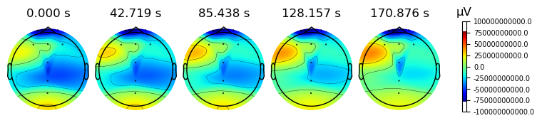
Topographical Analysis of EEG Data for the Task-Switch
Initial Observation:
Left Middle Frontal Lobe: Shows a green color, indicating moderate neural activity, surrounded by a greenish-blue area extending toward the left and lower parietal lobes.
Frontal Lobe: The front of the frontal lobe appears dark blue, suggesting low neural activity in the early stages.
Occipital Lobe: Exhibits a green color, indicating moderate activity associated with visual processing.
Remaining Areas: Display light blue, signifying low to moderate activity across the rest of the brain.
Changes Over Time:
Left Middle Frontal Lobe: An orange-yellow patch appears and grows, shifting to orange-reddish, indicating increasing neural activity as cognitive demands rise.
Surrounding Areas: Transition to a greenish-blue color, reflecting increasing engagement in nearby regions.
Occipital Lobe: Maintains its green color, indicating stable moderate visual activity throughout the task.
Frontal Lobe: The front remains dark blue, showing consistent low activity.
Middle of Frontal Lobe: Retains a slight bluish hue, suggesting stable low-level activity in this region.

Slide 26
Topographical Analysis of EEG Data for the Task-Switch
Inference:
Heightened Cognitive Engagement: The expanding orange-reddish patch in the left middle frontal lobe reflects a significant increase in neural activity, indicating the growing cognitive load of the task-switching paradigm.
Stable Visual Processing: The consistent green in the occipital lobe suggests ongoing visual processing, crucial for monitoring and adapting to task switches.
Executive Function: The increased activity in the left middle frontal lobe and surrounding regions highlights the critical role of executive functions—such as planning, decision-making, and cognitive flexibility—necessary for effectively managing task switches.
Neural Adaptation: The overall increase in activity levels across the brain suggests that subjects are dynamically reallocating neural resources to meet the evolving cognitive demands of task-switching.
This detailed analysis reveals how brain regions adapt to the shifting cognitive demands of task switching, emphasizing the pivotal role of the left middle frontal lobe in executive control while visual processing remains steady. These observations contribute to a deeper understanding of neural dynamics involved in attention and cognitive flexibility during complex cognitive tasks.

Slide 27
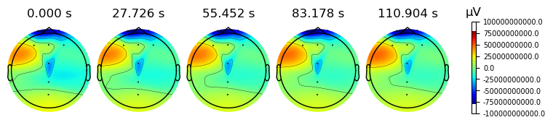
Topographical Analysis of EEG Data for Dual task
Initial Observation:
Left Frontal Lobe: Shows an orange-yellowish gradient patch, indicating high neural activity, likely linked to executive functions.
Occipital Lobe: Displays a lime green patch, suggesting moderate activity associated with visual processing.
Frontal Lobe (Front): Exhibits dark blue, reflecting low neural activity, typical of early cognitive engagement.
Overall: The remaining brain regions appear light blue, indicating low to moderate neural engagement across the rest of the brain.
Changes Over Time:
Left Frontal Lobe: The orange-yellowish patch intensifies, shifting to an orange-reddish hue, signifying increasing neural activity as cognitive load rises.
Surrounding Areas: The green gradient expands, covering the left parietal and occipital lobes, suggesting increased neural engagement in these regions.
Occipital Lobe: Maintains its green color, reflecting stable moderate activity related to visual processing demands.
Frontal Lobe (Front): Continues to show dark blue, indicating sustained low activity.
Middle Frontal Lobe: Retains a light bluish hue, reflecting relatively stable, low-level neural engagement.

Slide 28
Topographical Analysis for Dual task
Inference:
Heightened Cognitive Demand: The expanding and intensifying orange-yellowish patch in the left frontal lobe signals an increase in cognitive load as the dual task progresses, indicating greater involvement of executive functions like task coordination and decision-making.
Stable Visual Processing: The consistent green color in the occipital lobe reflects continuous visual processing, essential for responding to visual stimuli while managing multiple tasks.
Executive Function: The growing neural activity in the left frontal and parietal lobes highlights the significant role of executive functions, such as task-switching, attention allocation, and decision-making, critical for managing the complexities of the dual-task paradigm.
Neural Adaptation: The increase in overall brain activity suggests that participants are dynamically adjusting their neural resources to handle the escalating demands of the dual task, demonstrating neural plasticity and cognitive flexibility.
These insights provide a deeper understanding of how the brain adapts to the cognitive demands of a dual-task environment, underscoring the role of attention, executive function, and neural adaptation.

Slide 29
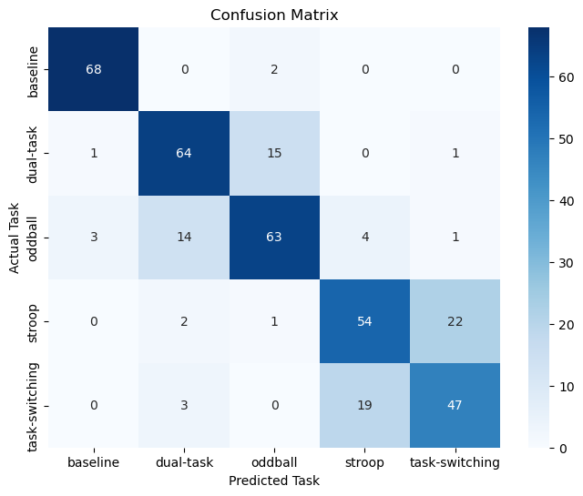
4. Results and Classification Performance
• Approach: Ensemble Voting Classifier (Random Forest, XGBoost, Support Vector Machine)
• Performance Metrics: 77% accuracy.
• Precision, Recall, F1-Score, Confusion Matrix

Slide 30
What Confusion Matrix tells us?
Here the confusion matrix tells us that in baseline case out of 72 cases the model predicts 68 cases successfully.
And for dual task case it successfully predicts 64 cases out of 83.
For odd ball case it successfully predicts 63 cases out of 81.
For stroop case it successfully predicts 54 cases out of 77.
For task-switching case it successfully predicts 47 cases out of 71.

Slide 31
Approach:
1. Data Preprocessing and Feature Extraction
The first step I focused on was preprocessing the EEG data, as raw EEG signals are noisy and need to be cleaned up for effective modeling. To do this, I applied a Butterworth bandpass filter to remove frequencies outside of the typical EEG ranges (1-50 Hz), which is critical for retaining meaningful signal characteristics. After filtering, I proceeded with feature extraction, where I focused on statistical features (mean, std, min, max) and frequency-domain features such as power in various EEG bands (delta, theta, alpha, beta, gamma). These features are essential for capturing the brain's electrical activity during different cognitive states.
The alpha-beta ratio and theta-alpha ratio were also calculated, which are often used in cognitive state classification tasks. These features have shown to be highly indicative of mental workload, relaxation, and alertness, making them especially useful for this classification problem.

Slide 32
Approach:
2. Class Imbalance Handling with SMOTE
As EEG datasets typically exhibit class imbalance, I decided to use SMOTE (Synthetic Minority Over-sampling Technique) to balance the dataset. This technique generates synthetic examples for underrepresented classes, which is critical when the number of samples in some classes is much lower than in others. By generating synthetic samples, SMOTE helps the model learn better decision boundaries for all classes, preventing it from being biased toward the majority class.

Slide 33
Approach:
3. Feature Selection
Next, I turned my attention to feature selection. I used Recursive Feature Elimination (RFE) with a RandomForestClassifier as the base estimator. RFE recursively removes less important features, helping to retain only the most significant ones. In my case, I decided to select the top 20 features, which reduced dimensionality and improved the model's generalizability.

Slide 34
Approach:
4. Modeling with XGBoost, RandomForest, and SVM
The core of my approach revolves around ensemble learning. To ensure that I leverage the strengths of multiple models, I decided to use a VotingClassifier, which combines the predictions of three classifiers: XGBoost, RandomForest, and SVM.
XGBoost: I chose XGBoost because of its ability to handle large datasets efficiently and its superior performance on structured/tabular data. XGBoost is known for its robustness, scalability, and high predictive accuracy. It uses gradient boosting, which sequentially builds trees and corrects the mistakes of previous models, making it a great choice for complex tasks like multiclass classification.
RandomForest: RandomForest is a stable, interpretable model that performs well with less hyperparameter tuning and is resistant to overfitting. It works by constructing multiple decision trees and averaging their predictions, which often leads to a high degree of accuracy in diverse datasets like EEG signals.
SVM (Support Vector Machine): I included SVM to take advantage of its ability to handle complex, high-dimensional spaces. SVMs are known for their effectiveness in classification problems where the decision boundary is not linear. I used the RBF kernel (Radial Basis Function), which works well for non-linear classification tasks and is particularly effective in signal-based problems like EEG classification.
By combining these three models in a VotingClassifier, I aimed to exploit their individual strengths, using soft voting to ensure that each model’s probabilities contributed to the final decision. This ensemble approach often outperforms individual models and leads to more robust predictions.

Slide 35
Approach:
5. Model Training and Evaluation
To evaluate the model’s performance, I used Stratified K-Fold cross-validation, ensuring that each fold preserves the percentage of samples for each class. This technique is essential when dealing with imbalanced datasets because it guarantees that each fold has a balanced representation of all classes.
After splitting the dataset into training and testing sets, I standardized the features using StandardScaler. Standardizing ensures that each feature has zero mean and unit variance, which is especially important for models like SVM, which are sensitive to the scale of the data.
For evaluation, I focused on several metrics:
Classification Report: This includes precision, recall, and F1-score for each class, which provides a detailed view of the model's performance. Precision and recall are crucial in imbalanced datasets, as they help assess whether the model is correctly identifying minority classes.
Confusion Matrix: This helped me visualize the performance of the classifier across all classes and identify areas where the model might be confused between classes. It was important to visualize this, especially since EEG data can be complex and have overlapping features across classes.

Slide 36
Approach:
6. Model Tuning and Hyperparameter Optimization
One of the crucial next steps after the initial model training is hyperparameter tuning. Although I didn’t implement this step in the current script, I plan to fine-tune the models using GridSearchCV or RandomizedSearchCV to optimize hyperparameters like:
XGBoost: Learning rate, number of estimators, and maximum depth.
RandomForest: Number of estimators, max depth, and min samples per leaf.
SVM: Regularization parameter (C) and kernel parameters (gamma).
This step is important to further boost performance, as model accuracy can often be significantly improved by choosing the optimal hyperparameters.

Slide 37
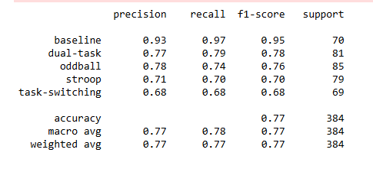
Performance Metrics:
This tells us that the precision of our multiclassicfication model is 77% overall.

Slide 38
Betterment:
After running the initial models, I am pleased with the performance of the ensemble classifier, especially considering the complexity of EEG signals. However, I recognize that there are areas for improvement. I plan to experiment with more advanced feature extraction techniques (e.g., wavelet transforms or higher-order spectral features) and explore additional classifiers (e.g., lightGBM, deep learning models) to further improve results.
I am also keen on exploring model interpretability techniques like SHAP and LIME to understand how different features contribute to the model's predictions. This would provide insights into the brain regions or activities most predictive of the paradigms in the classification task.
Overall, the combination of XGBoost, RandomForest, and SVM, with an ensemble approach, has provided solid results, and I look forward to fine-tuning the model further to improve its performance on this challenging EEG-based multiclass classification problem.

Slide 39
5. Discussion
5.1 Key Findings
• Variations in neural signatures across different attention paradigms
• Distinctive frequency band characteristics for each cognitive task
• Successful multiclass classification of attention states

Slide 40
Variations in neural signatures across different attention paradigms
EEG data analysis across multiple attention tasks reveals distinct neural patterns, reflecting how cognitive demands shape brain activity:
1. Oddball Task:
Frontal Region: Shows increased localized activity, indicating decision-making and response inhibition.
Occipital Region: Moderate activity, essential for visual processing and detecting target stimuli.
Parietal Region: Low to moderate activity, supporting sensory integration and attention.
Consistency: Steady neural engagement suggests efficient processing of repetitive stimuli.

Slide 41
Variations in neural signatures across different attention paradigms
Stroop Task:
Left Middle Frontal Gyrus: Initially moderate activity, increasing over time, highlighting cognitive control and conflict resolution.
Occipital Lobe: Consistent moderate activity, crucial for word-color identification.
Parietal Lobe: Low to moderate engagement, assisting with sensory integration and attention.
Dynamic Changes: Continuous adaptation to cognitive demands indicates shifting focus and mental effort.

Slide 42
Variations in neural signatures across different attention paradigms
Task-Switching:
Left Middle Frontal Lobe: Increased activity, reflecting executive functions like planning and decision-making.
Occipital Lobe: Stable moderate activity, maintaining visual processing.
Frontal & Parietal Lobes: Rising activity levels, signifying neural adaptation to task-switching demands.
Cognitive Flexibility: Highlights the brain's capacity for mental shifting and task reconfiguration.

Slide 43
Variations in neural signatures across different attention paradigms
Dual-Task:
Left Frontal Lobe: High neural activity, indicating significant cognitive load from multitasking.
Occipital Lobe: Moderate activity, necessary for visual tasks.
Parietal Lobe: Rising activity, reflecting engagement in sensory integration and managing multiple tasks.
Neural Resource Allocation: Demonstrates how the brain allocates resources to handle simultaneous cognitive demands.

Slide 44
Distinctive Frequency Band Characteristics for Each Cognitive Task
Frequency band analysis reveals how different cognitive tasks engage specific neural frequencies:
1. Gamma Power:
Dual-Task & Task-Switching: Increased gamma power over time, reflecting heightened cognitive load and sustained engagement.
Oddball & Stroop Tasks: Stable gamma power, indicating steady cognitive demands and neural responses.

Slide 45
Distinctive Frequency Band Characteristics for Each Cognitive Task
2. Beta Power:
Similar Pattern to Gamma: Increased beta power across tasks, suggesting parallel neural engagement in attention and cognitive control.

Slide 46
Distinctive Frequency Band Characteristics for Each Cognitive Task
3. Theta Power:
Baseline High, Decreases During Tasks: Initially elevated during resting states, theta power decreases as cognitive engagement intensifies across tasks.

Slide 47
Distinctive Frequency Band Characteristics for Each Cognitive Task
4. Alpha Power:
Task-Dependent Variation: Alpha power varies by task, with neutral levels in some tasks and slightly positive in others, reflecting different levels of cognitive control and sensory processing.

Slide 48
Distinctive Frequency Band Characteristics for Each Cognitive Task
5. Delta Power
Baseline Task:
A few subjects exhibit extremely high delta power outliers, indicating significant neural relaxation or disengagement.
Cognitive Tasks:
Some subjects have delta power outliers that are not above average, suggesting consistent neural activity across Dual Task, Oddball, Stroop, and Task Switching tasks. This stable pattern indicates a consistent neural response and efficiency in cognitive processing.

Slide 49
Successful Multiclass Classification of Attention States
EEG-based classification of attention states shows the potential for distinguishing between different cognitive tasks:
Feature Engineering: Carefully selected EEG features form the foundation for accurate classification.
Model Training & Evaluation: Machine learning models effectively classify neural signatures, distinguishing between tasks.
Optimization & Innovation: Continuous optimization of models ensures high classification accuracy and reliable task differentiation.

Slide 50
6. Conclusion
EEG analysis across various attention tasks reveals distinct neural patterns reflecting cognitive demands. In the Oddball task, steady engagement in visual and frontal regions suggests efficient processing of repetitive stimuli. The Stroop task highlights dynamic changes in the left middle frontal lobe, indicating cognitive control and conflict resolution. Task-Switching shows increased activity in frontal and parietal regions, reflecting cognitive flexibility, while the Dual-Task paradigm demonstrates the brain's ability to allocate resources for multitasking.
Frequency band analysis highlights task-specific patterns: gamma and beta power reflect sustained engagement and cognitive control, while theta and alpha power indicate variations in attention regulation. Delta power remains stable across tasks, with occasional outliers suggesting neural relaxation during baseline phases.
The successful multiclass classification of attention states underscores EEG's potential to differentiate cognitive tasks, offering insights into neural dynamics and cognitive load. These findings support the Brainathon-2025 goal of advancing attention research through EEG, with applications in cognitive monitoring, human-computer interaction, and clinical diagnostics.

Slide 51
7. Future Recommendations
• Expand dataset size
• Explore deeper neural network architectures
• Investigation of individual differences in attention processing

Slide 52
8. Acknowledgments
Special thanks to the Brainathon-2025 organizing committee and mentors.

